Slide 1
Energy planning and EROI
Bertrand Cornélusse
2022-10-14
ENVT3065

Slide 2
Plan
Introduction
World energy outlook
Energy planning
Planning to maximize « Energy return on energy invested », the case of Belgium

Slide 3
Introduction

Slide 4
Power and energy

Slide 5
Introduction: an e-bike
Hints: the size of the battery, and the power of the motor.
What does the battery store?
Some energy measured in joules (J) or watt-hours (Wh): 1Wh = 3600J.
How fast is the energy delivered?
It depends on the power of the motor, measured in watts (W)
Good to know: an e-bike has a typical battery size of 500Wh, and the power of the motor is 250W.
You want to buy an electric bike. You already
decided on the type, the color, etc. How do you
decide on the electrical part? What are the
typical options you could have?

Slide 6
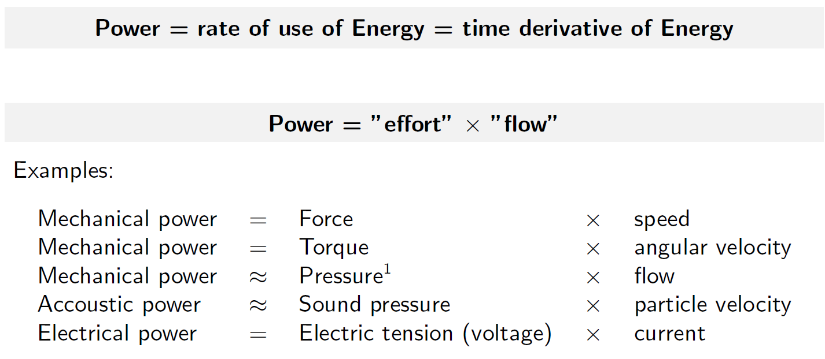
Power definition

Slide 7
Units of power and energy in energy systems
Power typically ranges from
kW e.g. PV panels
to GW e.g. nuclear power plant
Energy typically ranges from
Several kWh: daily production of a residential PV plant, or 1l of oil
To thousands of TWh: consumption of a country over a year
One ExaJoule (EJ) = 277,78 TWh
“The ton of oil equivalent (toe) represents the quantity of energy contained in a ton of crude oil, that is gigajoules 41.868. This unit is used to express and compare energies of different sources. According to the international conventions, one ton of oil equivalent amounts for example in 1 616 kg of coal, 1 069 m³ of gas from Algeria or 954 kg of gasoline. For electricity, 1 toe is worth 11.6 MWh (caution here).” (from https://www.insee.fr/en/metadonnees/definition/c1355)

Slide 8

Robert and the toaster: https://youtu.be/S4O5voOCqAQ

Slide 9
Renewable energy sources

Slide 10
Definition
Renewable energy is energy derived from natural sources that are replenished at a higher rate than they are consumed.
Sunlight and wind, for example, are such sources that are constantly being replenished. Renewable energy sources are plentiful and all around us.
Fossil fuels - coal, oil, and gas - on the other hand, are non-renewable resources that take hundreds of millions of years to form. Fossil fuels, when burned to produce energy, cause harmful greenhouse gas emissions, such as carbon dioxide.
Source: https://www.un.org/en/climatechange/what-is-renewable-energy

Slide 11
Solar energy
Solar energy is the most abundant of all energy resources (…).
The rate at which solar energy is intercepted by the Earth is about 10,000 times greater than the rate at which humankind consumes energy.
Solar technologies can deliver heat, natural lighting, electricity, …
Electrical energy either through photovoltaic panels or through mirrors that concentrate solar radiation.
(…) A significant contribution to the energy mix from direct solar energy is possible for every country.
The cost of manufacturing solar panels has plummeted dramatically in the last decade, making them affordable and often the cheapest form of electricity. Solar panels have a lifespan of roughly 30 years, ….
Source: https://www.un.org/en/climatechange/what-is-renewable-energy

Slide 12
Photovoltaic generation
A PV cell is composed of semiconductor material. Photons emitted by the sun interact with the semiconducting material in two ways:
photons directly transmit energy to electrons and allow them to move into the conduction band.
a thermally generated current as in a p-n junction (diode).
See https://youtu.be/L_q6LRgKpTw

Slide 13
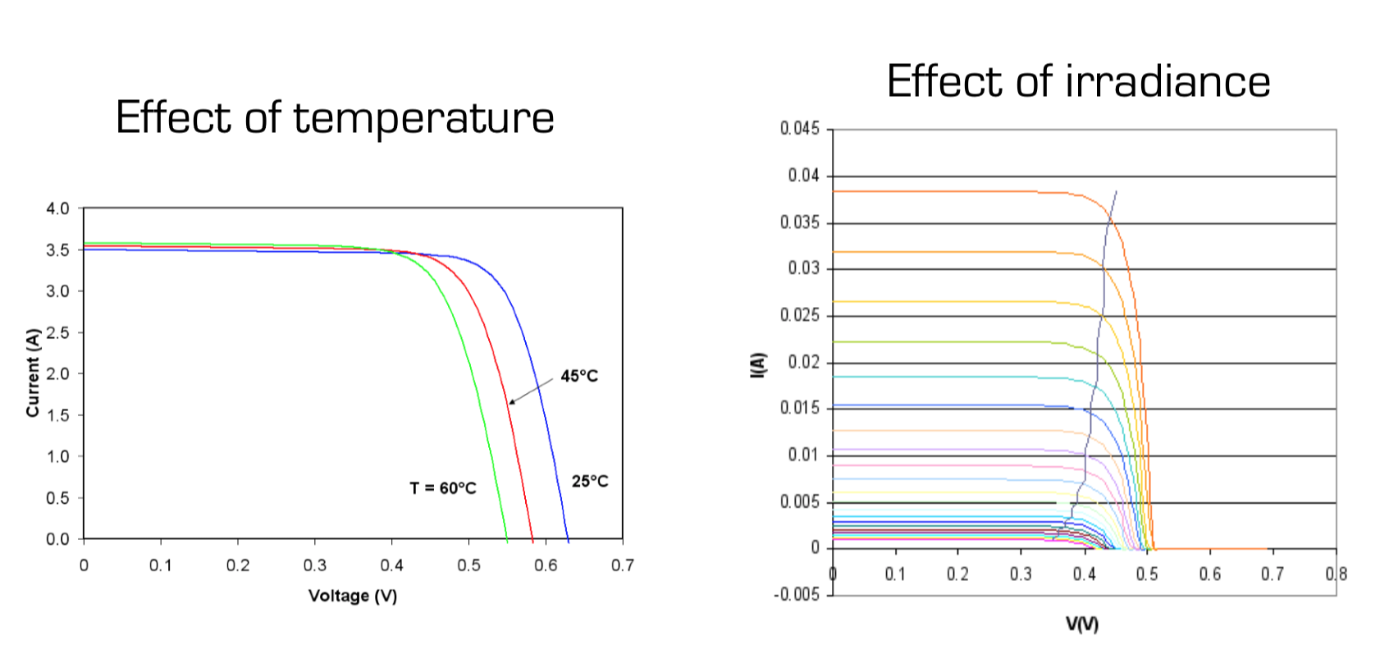
Effect of irradiance and temperature
Sources:
https://en.wikipedia.org/wiki/Theory_of_solar_cells https://en.wikipedia.org/wiki/Maximum_power_point_tracking

Slide 14
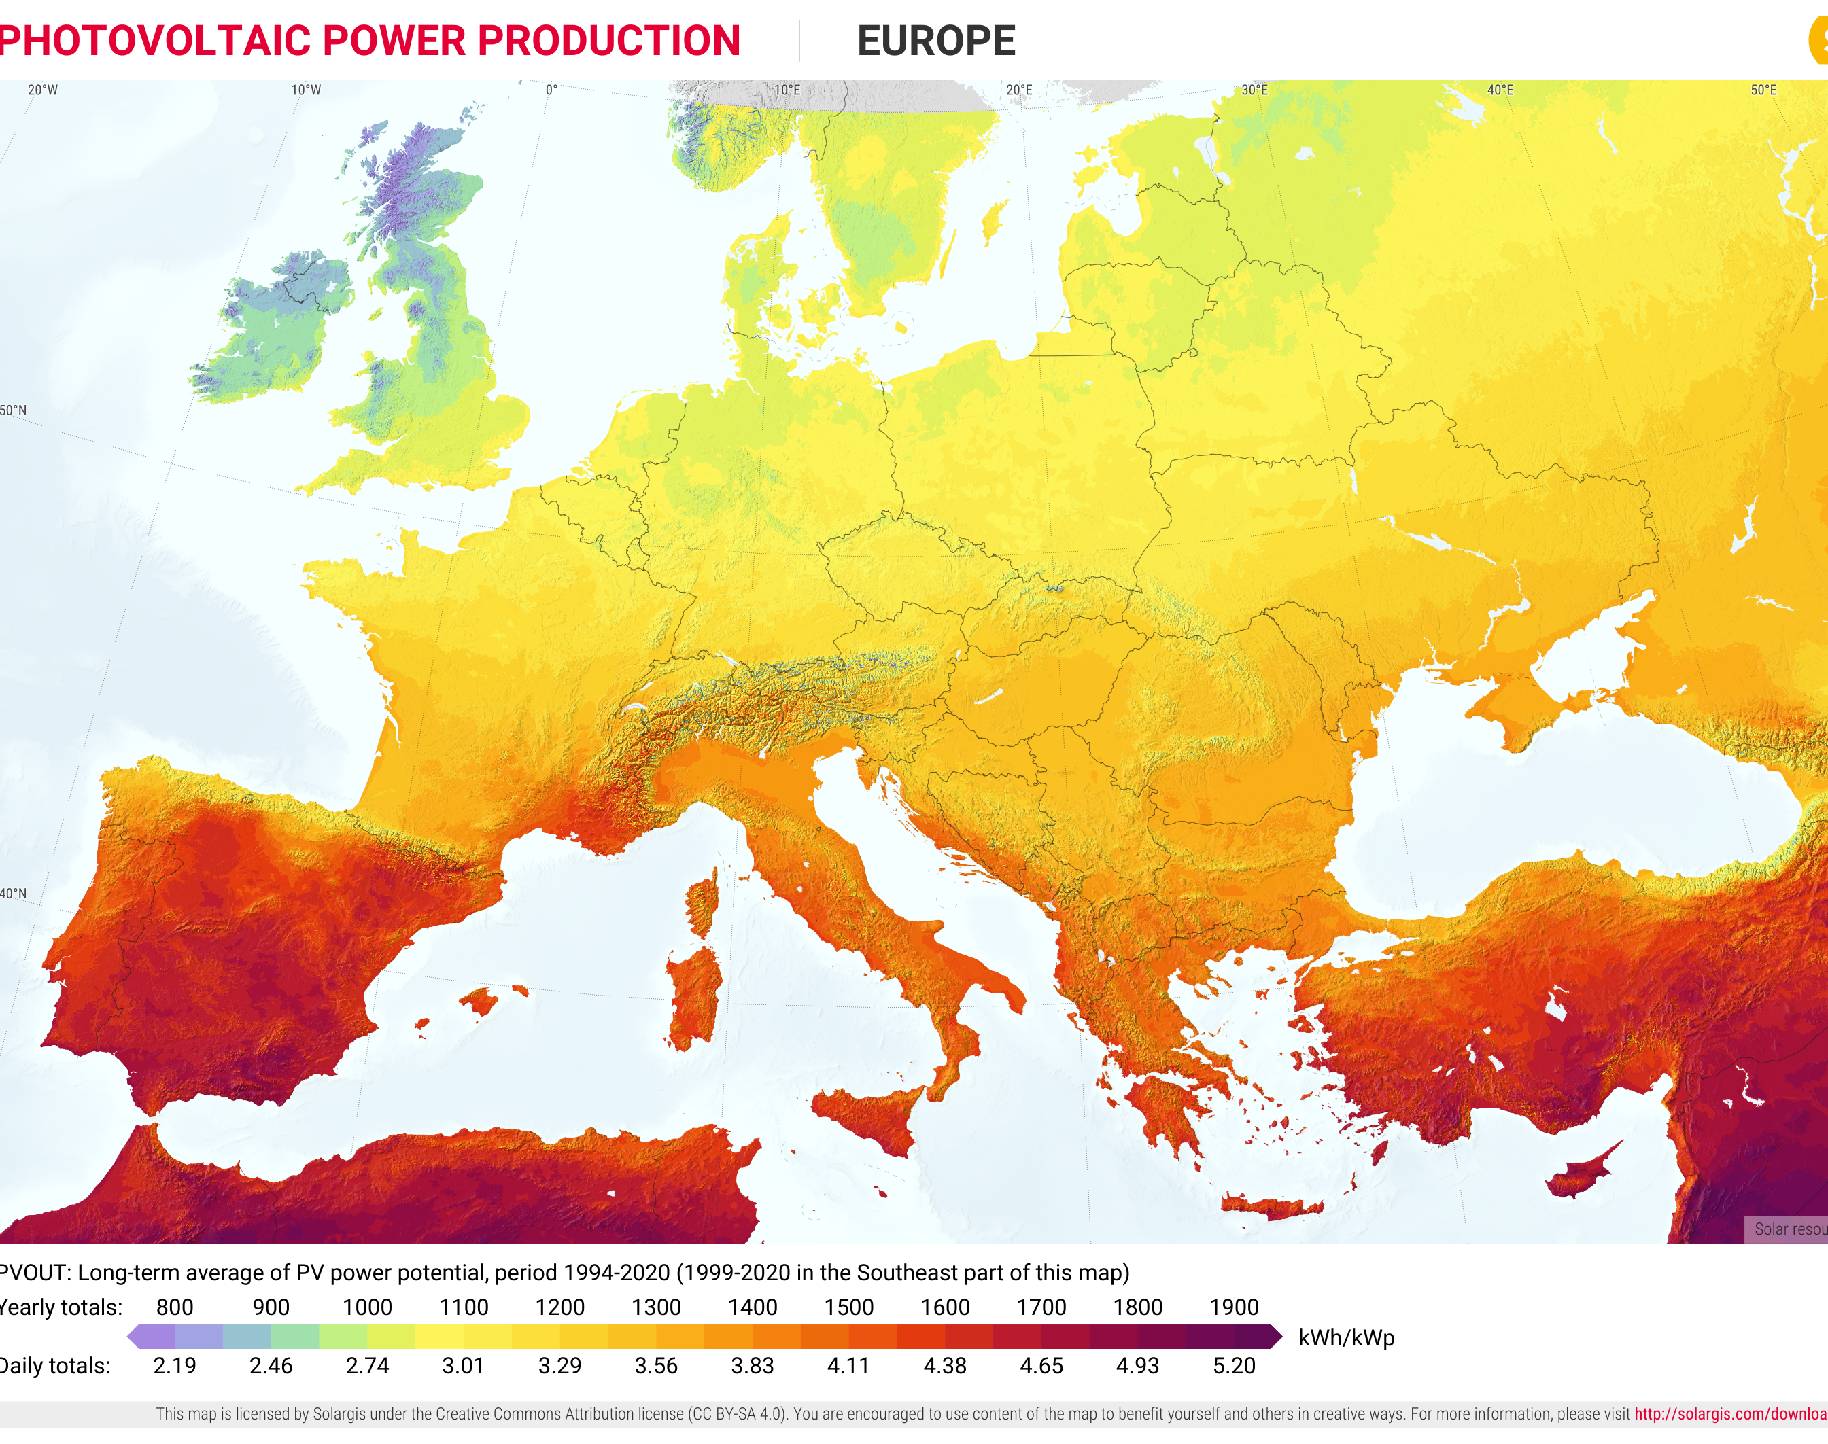
Photovoltaic power production potential
Source: https://solargis.com/maps-and-gis-data/download/europe
How many kWh per kWP in Belgium?
Note: also depends on the orientation of PV panels and other factors

Slide 15
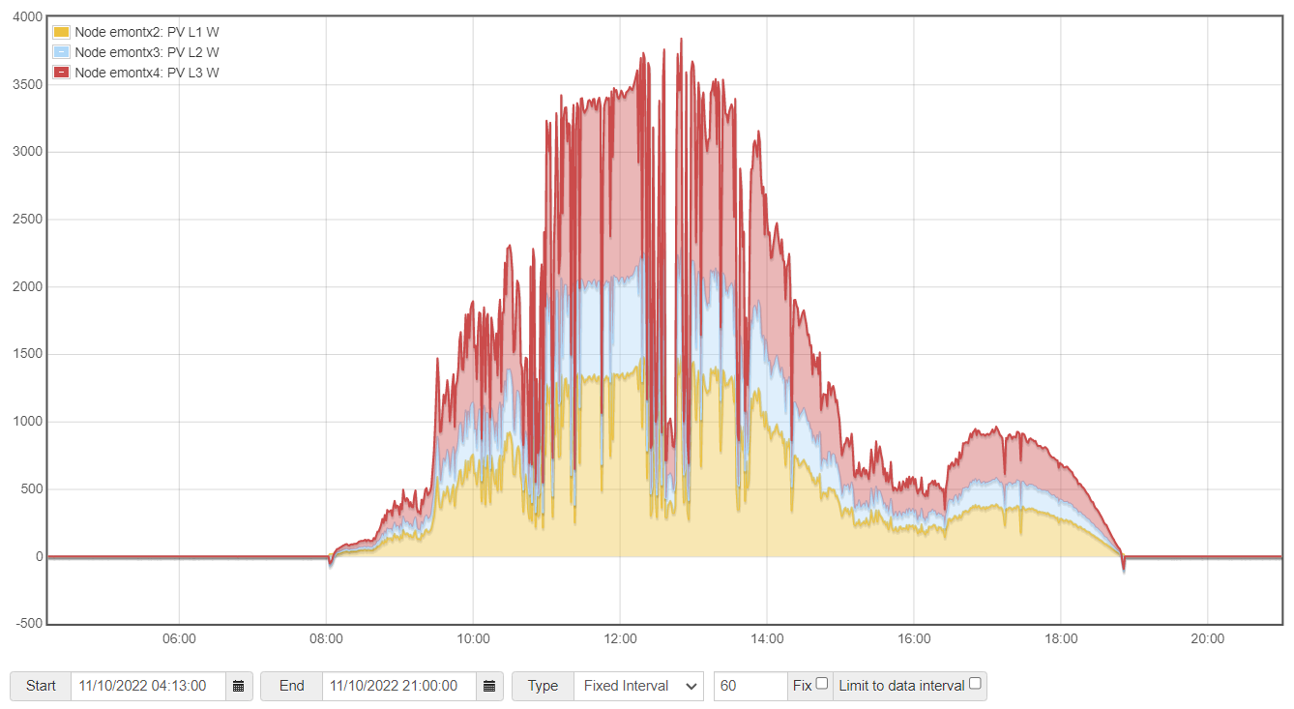
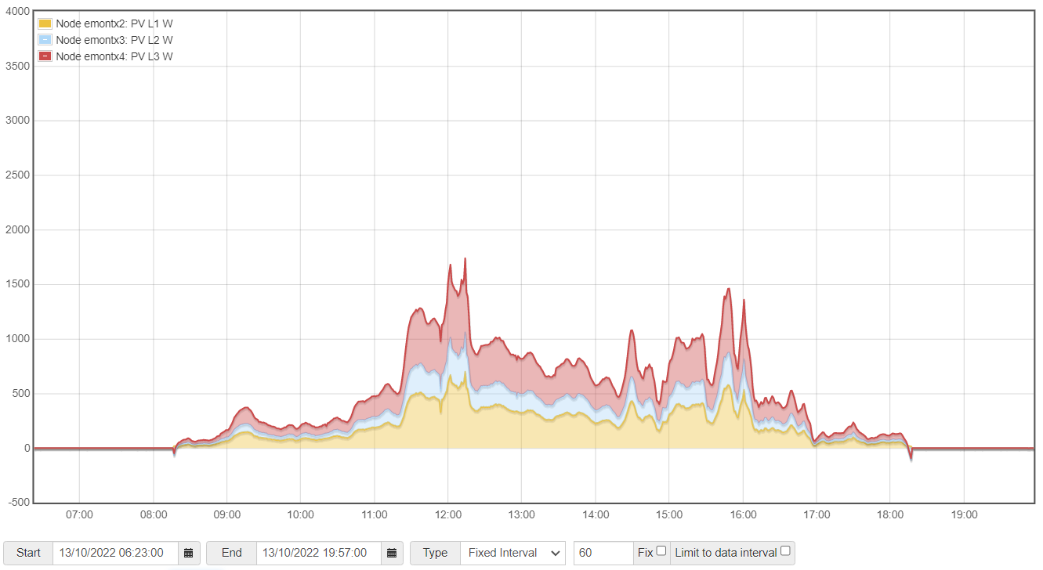
PV variability

Slide 16
Wind energy
Wind energy harnesses the kinetic energy of moving air by using large wind turbines located on land (onshore) or in sea- or freshwater (offshore). Wind energy has been used for millennia, but onshore and offshore wind energy technologies have evolved over the last few years to maximize the electricity produced - with taller turbines and larger rotor diameters.
Though average wind speeds vary considerably by location, the world’s technical potential for wind energy exceeds global electricity production, and ample potential exists in most regions of the world to enable significant wind energy deployment.
Many parts of the world have strong wind speeds, but the best locations for generating wind power are sometimes remote ones. Offshore wind power offers tremendous potential.

Slide 17

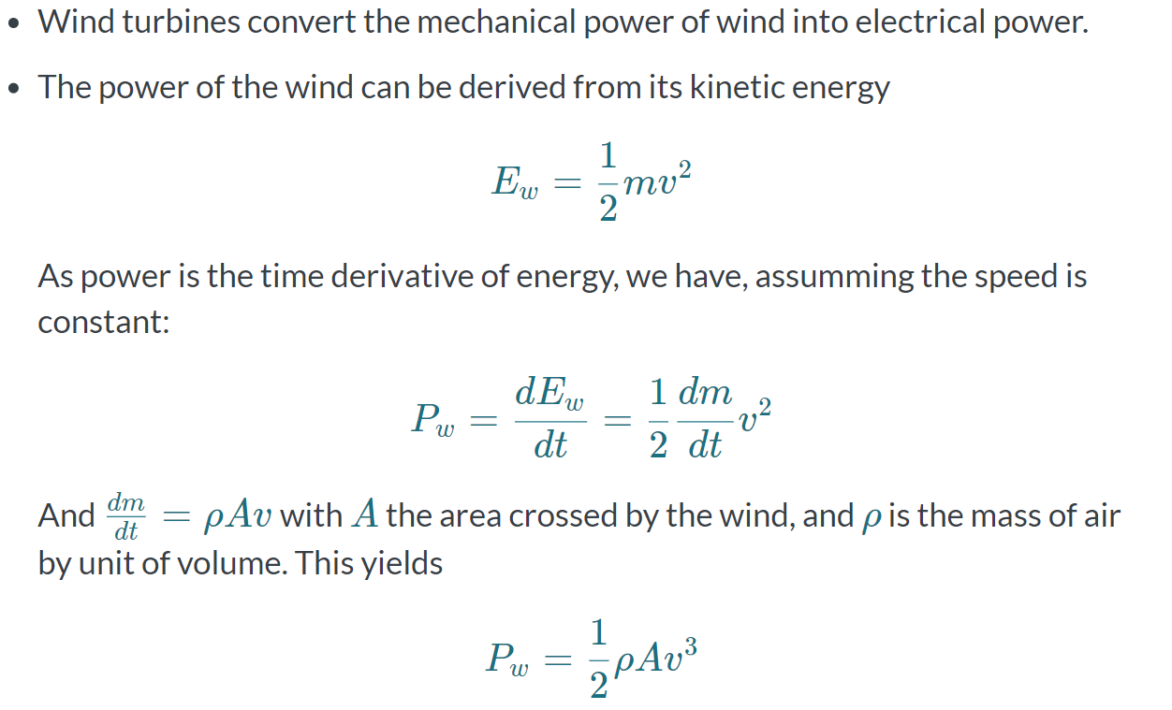
Wind turbines

Slide 18
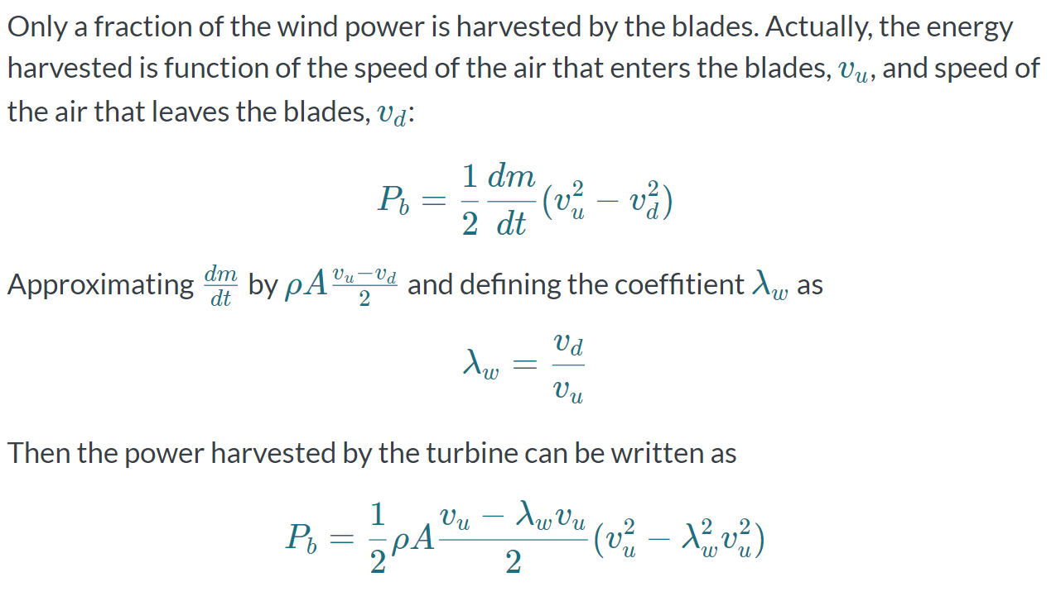
Power conversion

Slide 19
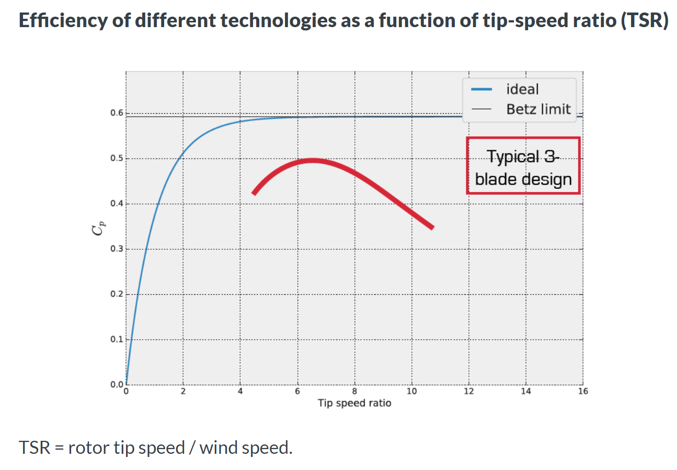
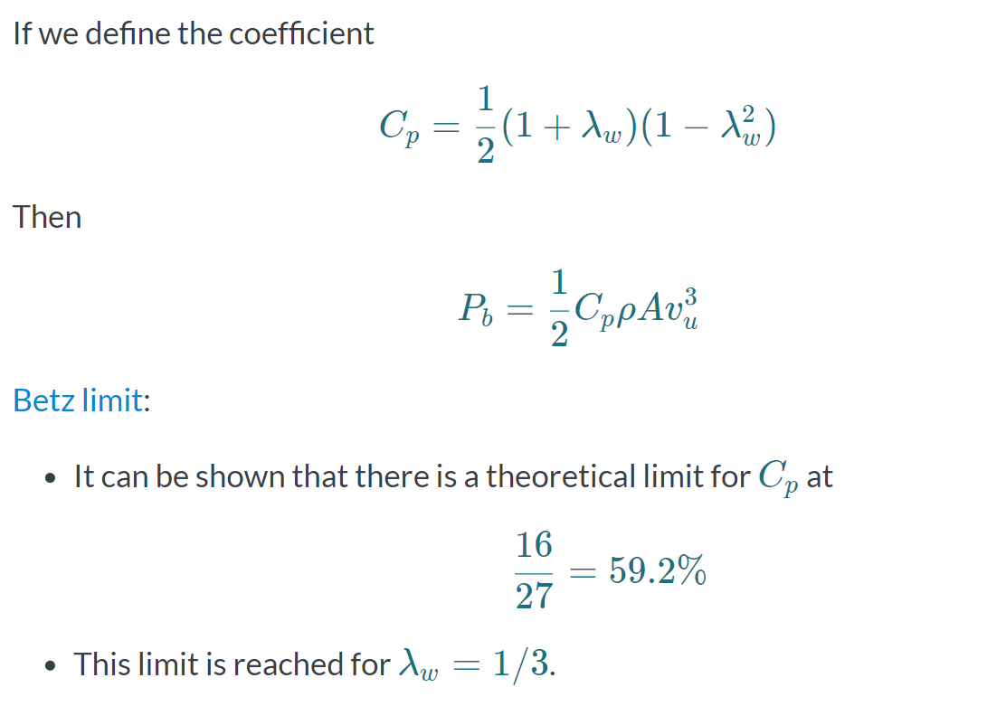
Turbine efficiency

Slide 20
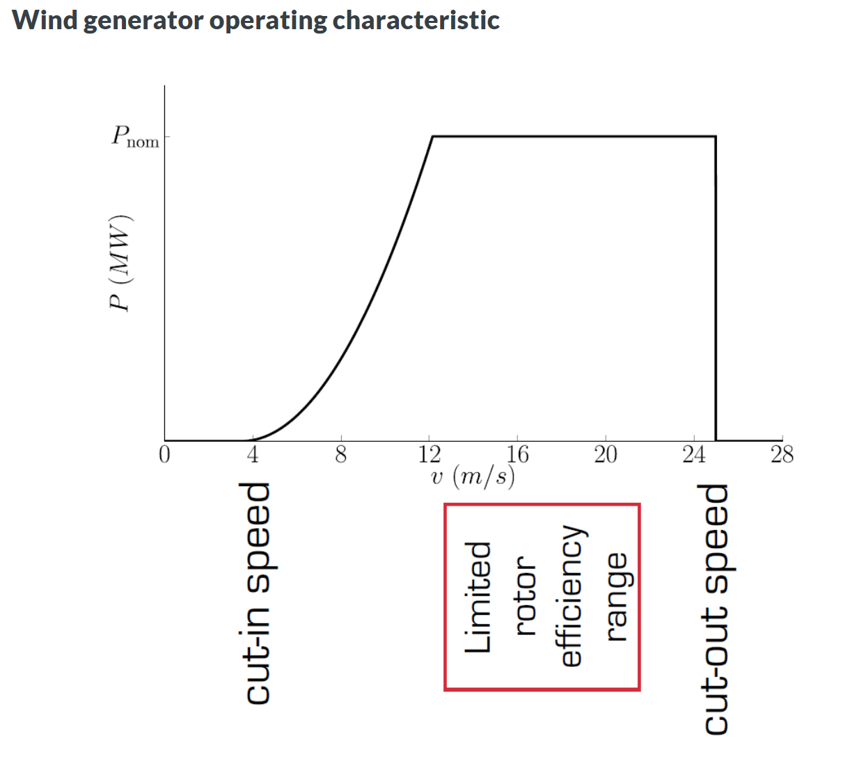
Wind generator operating characteristic

Slide 21
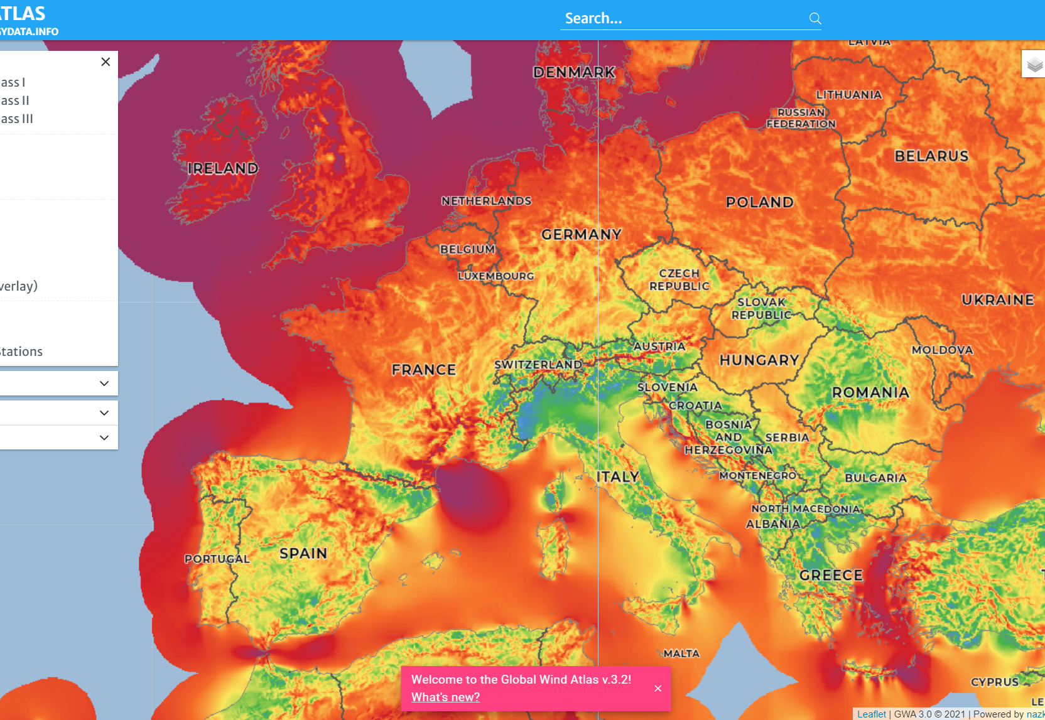
Wind atlas
Source: https://globalwindatlas.info/en
How many MWh per MWP in Belgium?
Offshore vs. onshore?

Slide 22
Other sources
Geothermal energy
Hydropower
Bioenergy

Slide 23
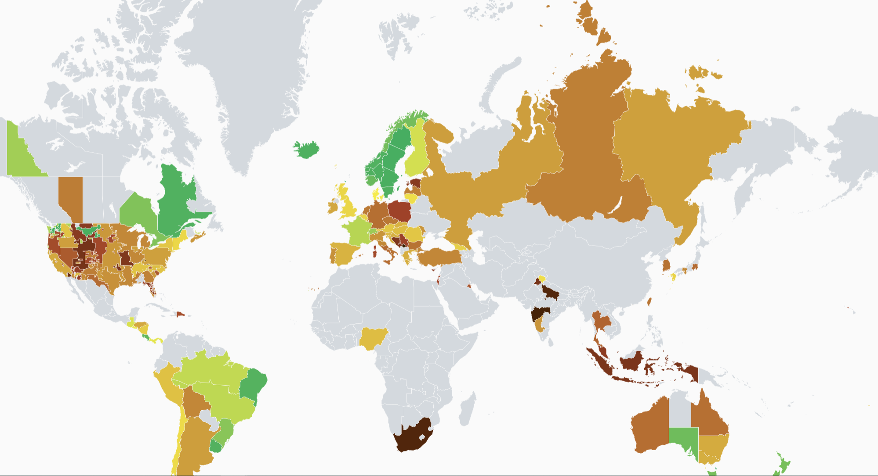
CHG emissions related to electricity consumption
https://app.electricitymaps.com/map

Slide 24
World energy outlook

Slide 25
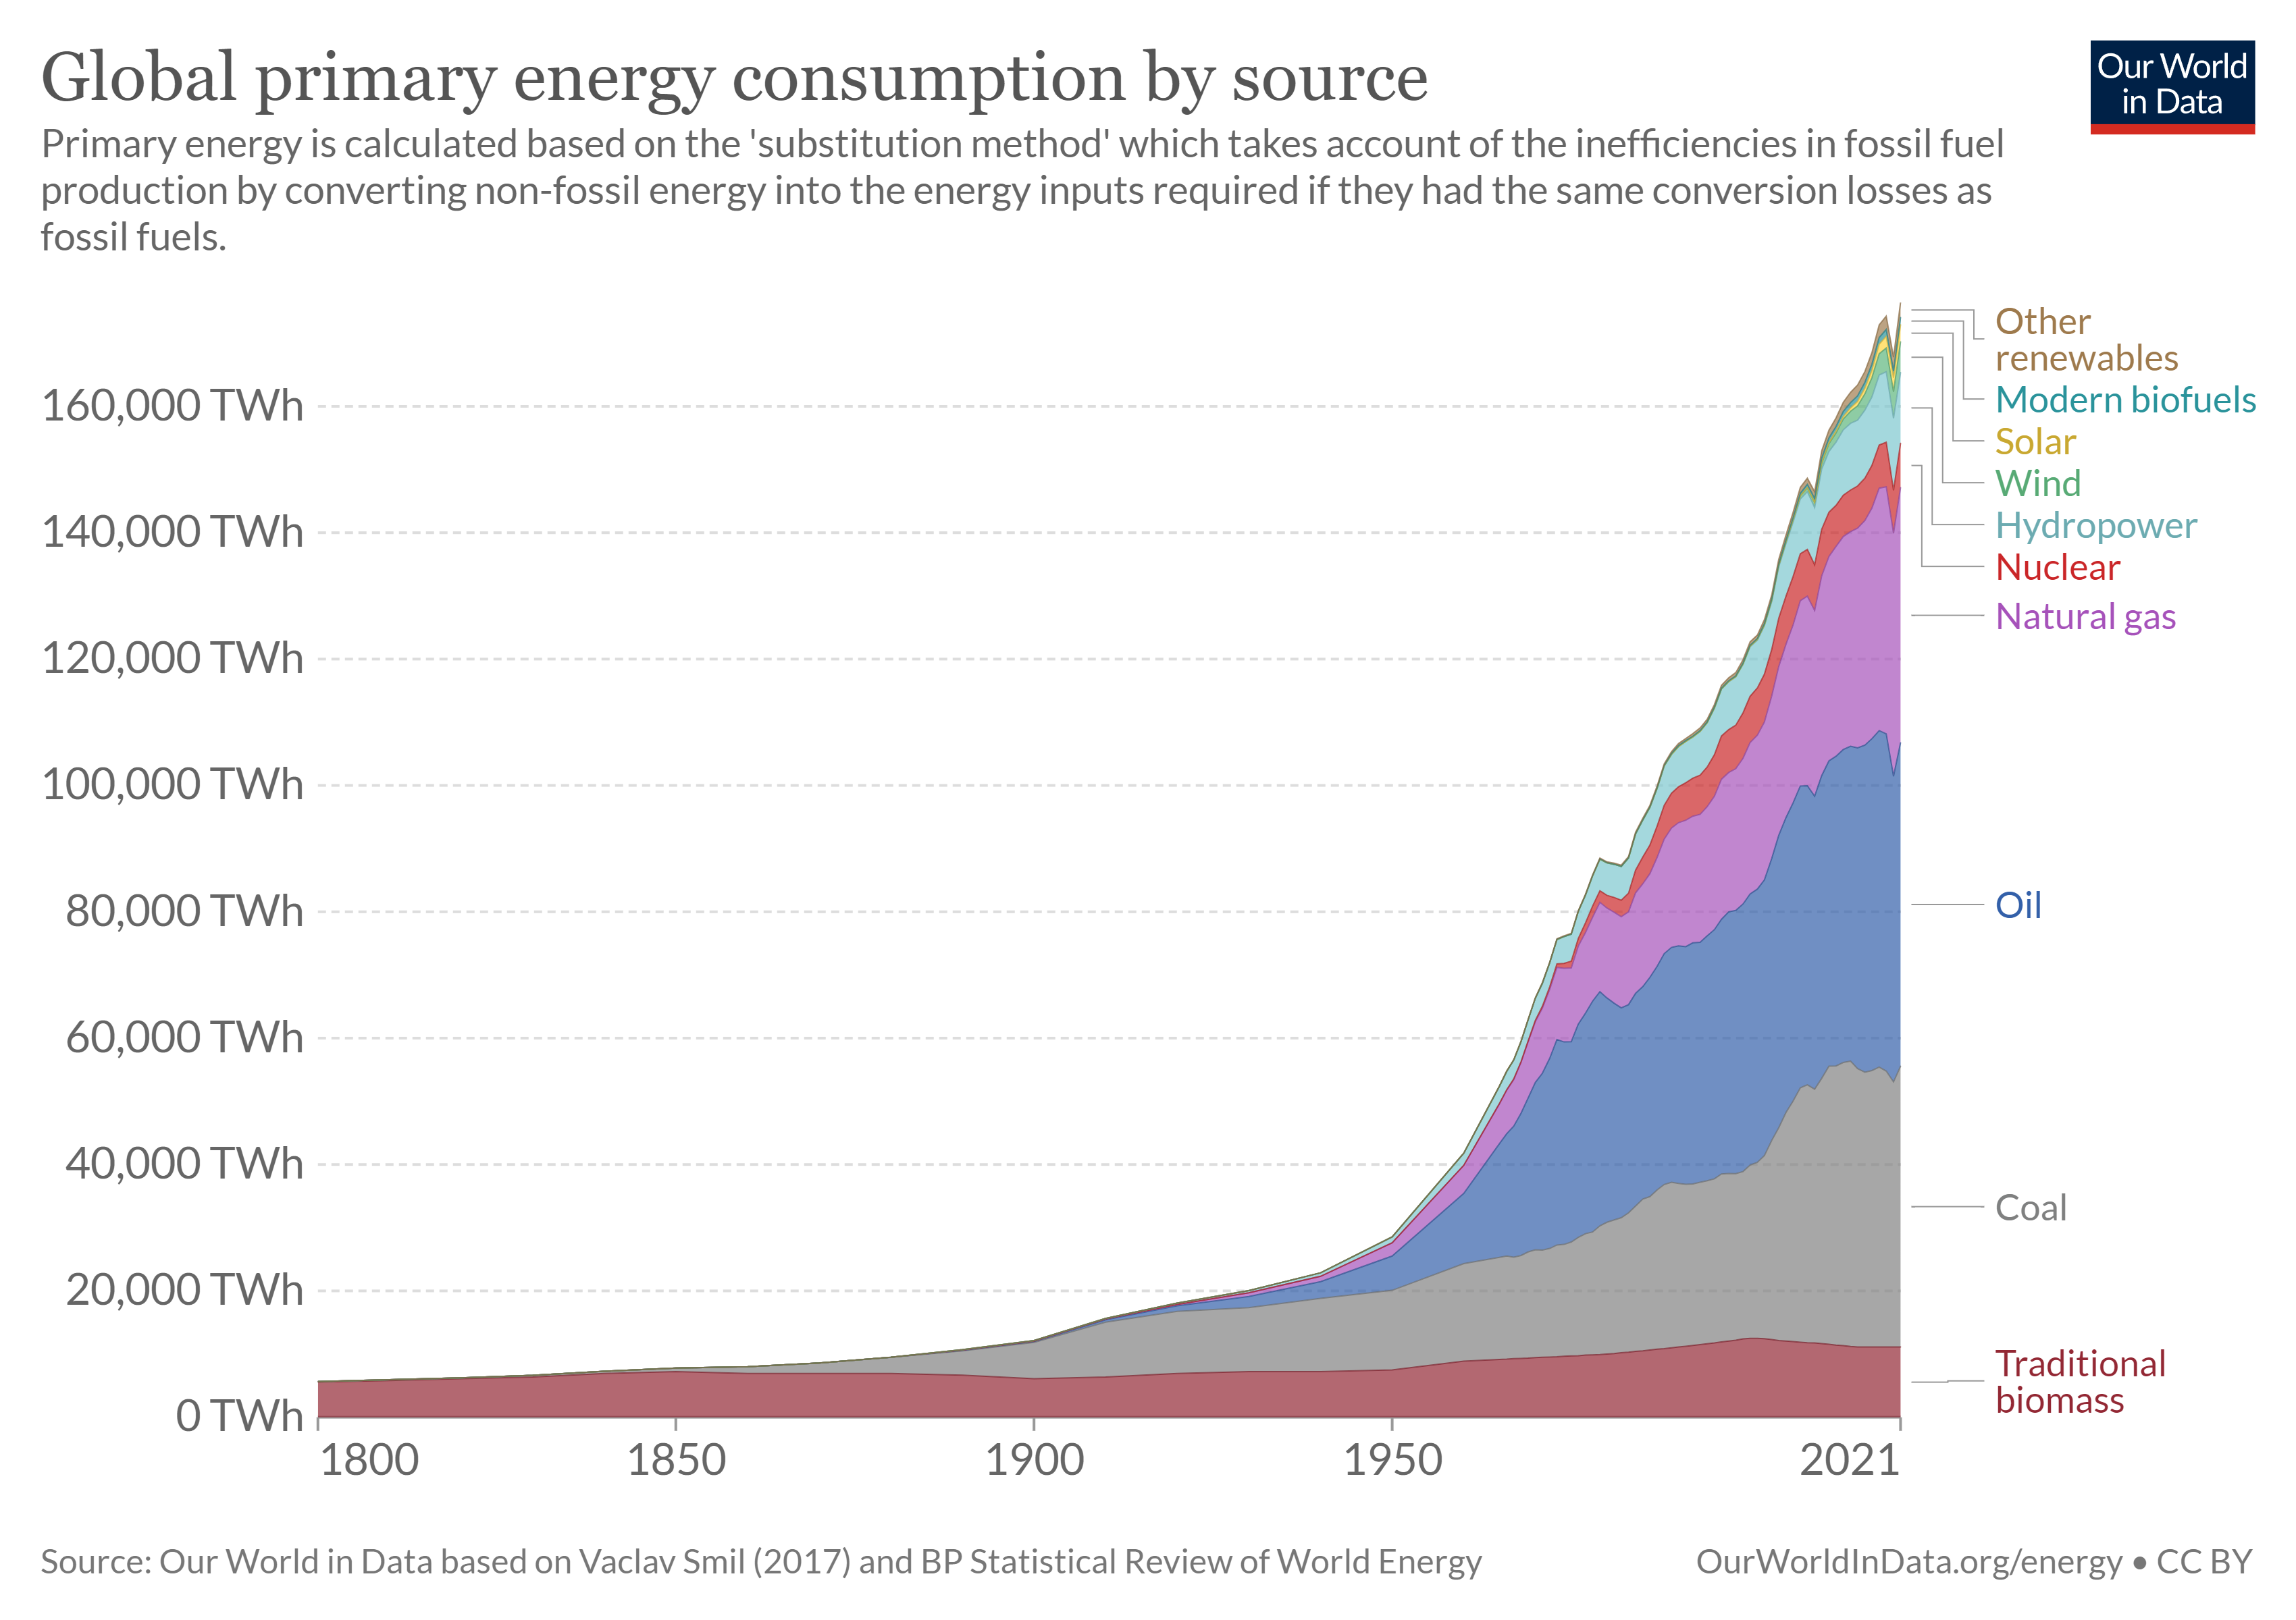
World energy consumption

Slide 26
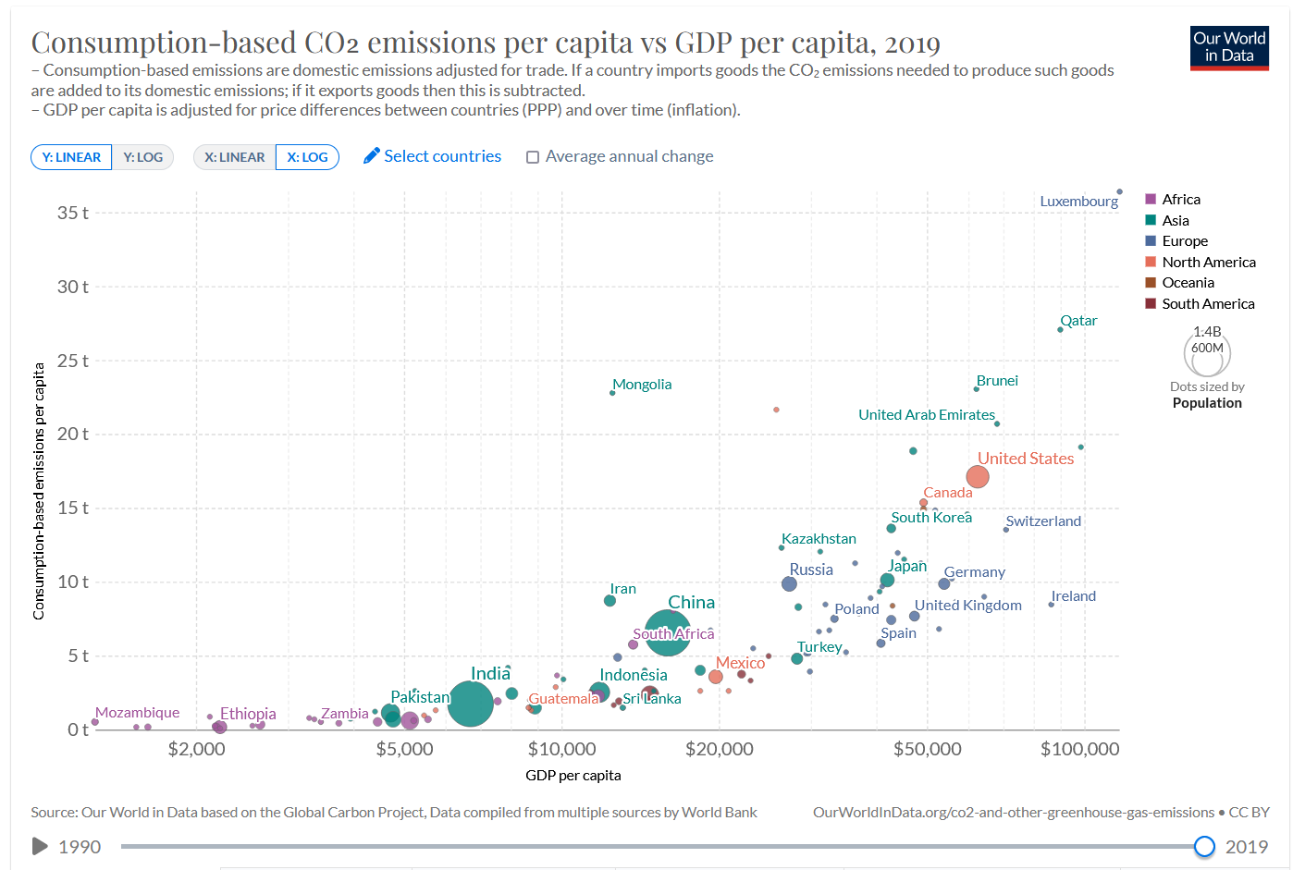
Consumption-based CO₂ emissions per capita vs GDP per capita, 2019
CO2 emissions are directly related to our consumption / production
https://ourworldindata.org/worlds-energy-problem

Slide 27
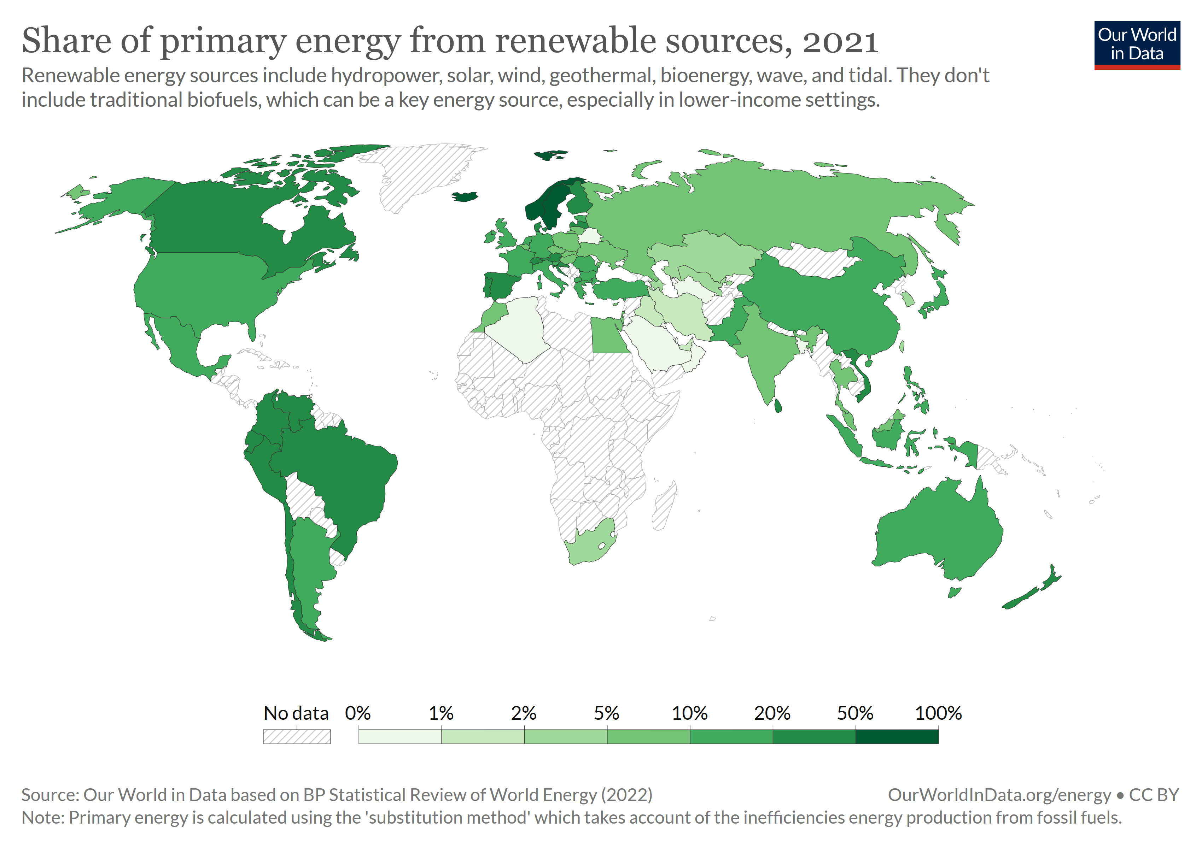
Share of primary energy from renewable sources, 2021

Slide 28
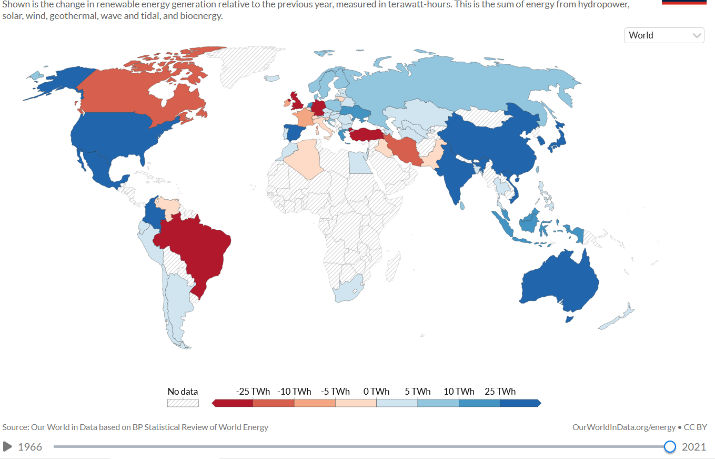
Annual change in renewable energy generation, 2021
Source: https://ourworldindata.org/grapher/annual-change-renewables

Slide 29
See also
A great references to dig: is IEA’s, World Energy Outlook. The latest one: https://www.iea.org/reports/world-energy-outlook-2021

Slide 30
Energy planning

Slide 31
Definition of energy planning
Energy planning aims at determining in which types of energy sources, transmission and conversion systems we want to invest to satisfy some needs for
Mobility
Industry
Heating
Agriculture
Etc.
The plan should be sustainable and in line with CO2 emission targets

Slide 32
Energy sources
Renewable energy sources
Nuclear energy
Fossil fuels

Slide 33
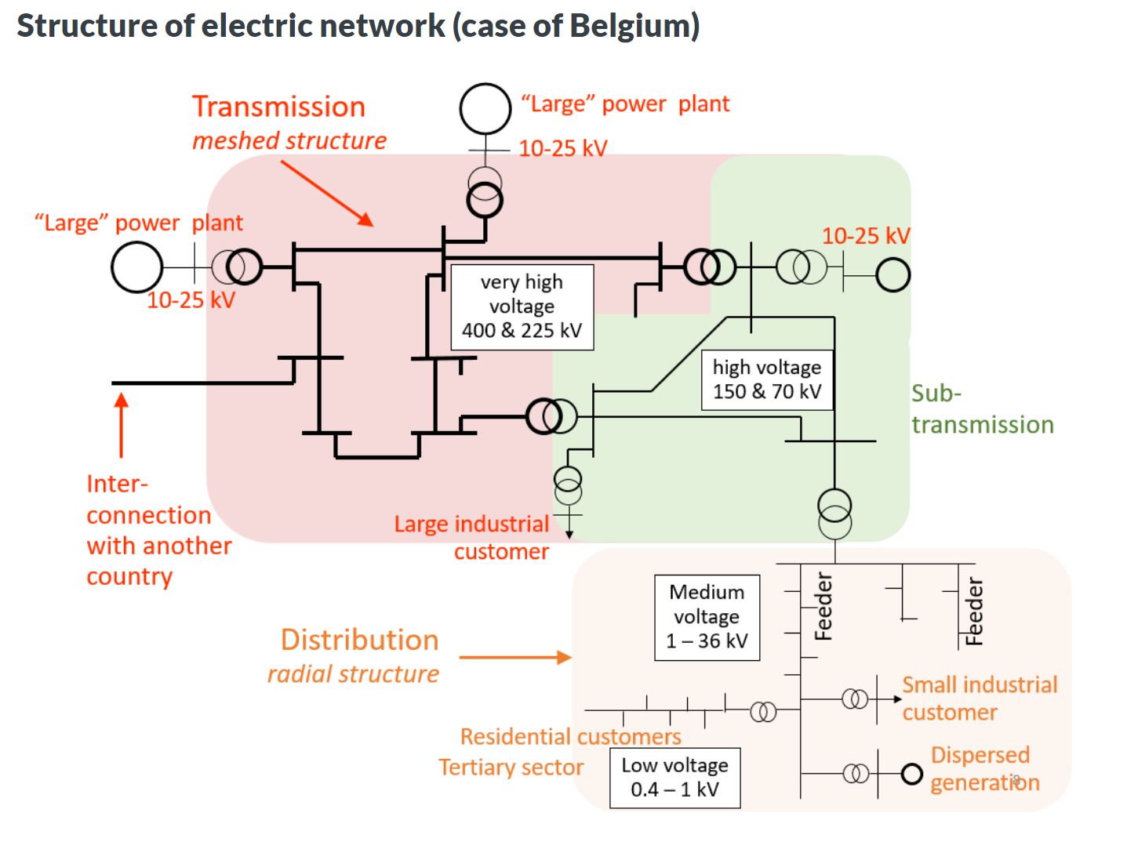
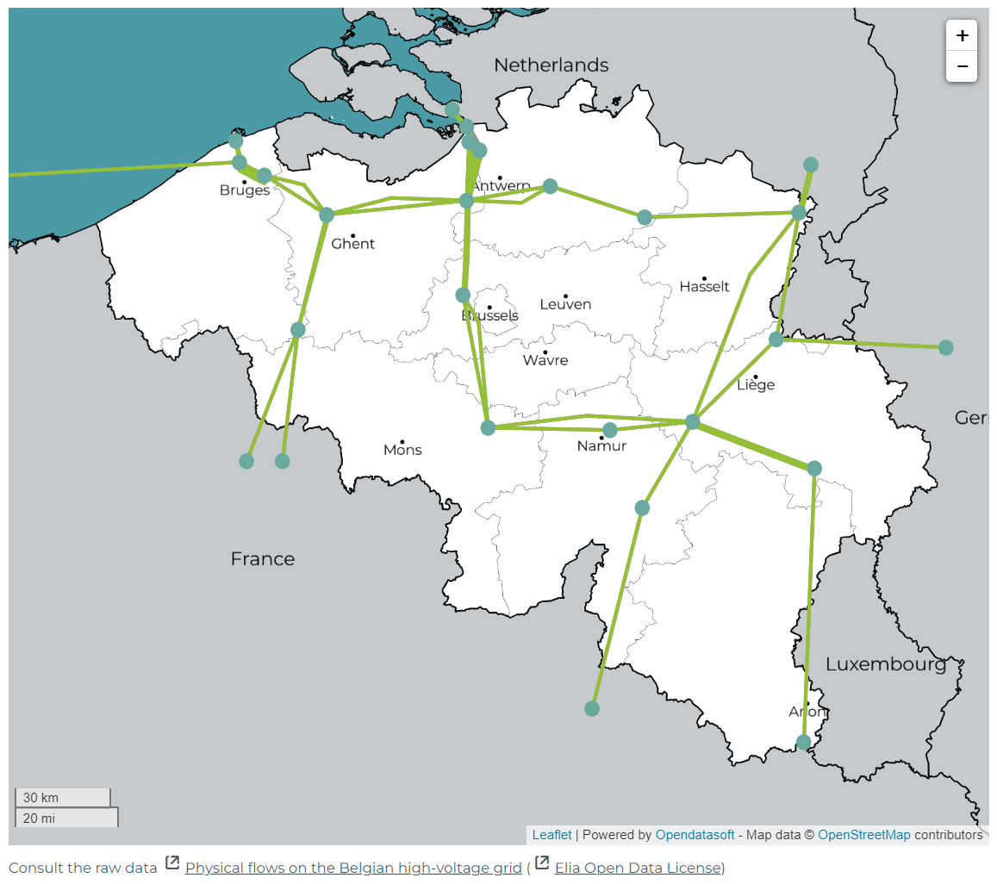
Transmission and distribution systems - electricity
https://www.elia.be/fr/donnees-de-reseau/transport/flux-de-bouclage-par-frontiere/flux-physiques-sur-le-reseau-haute-tension-belge

Slide 34
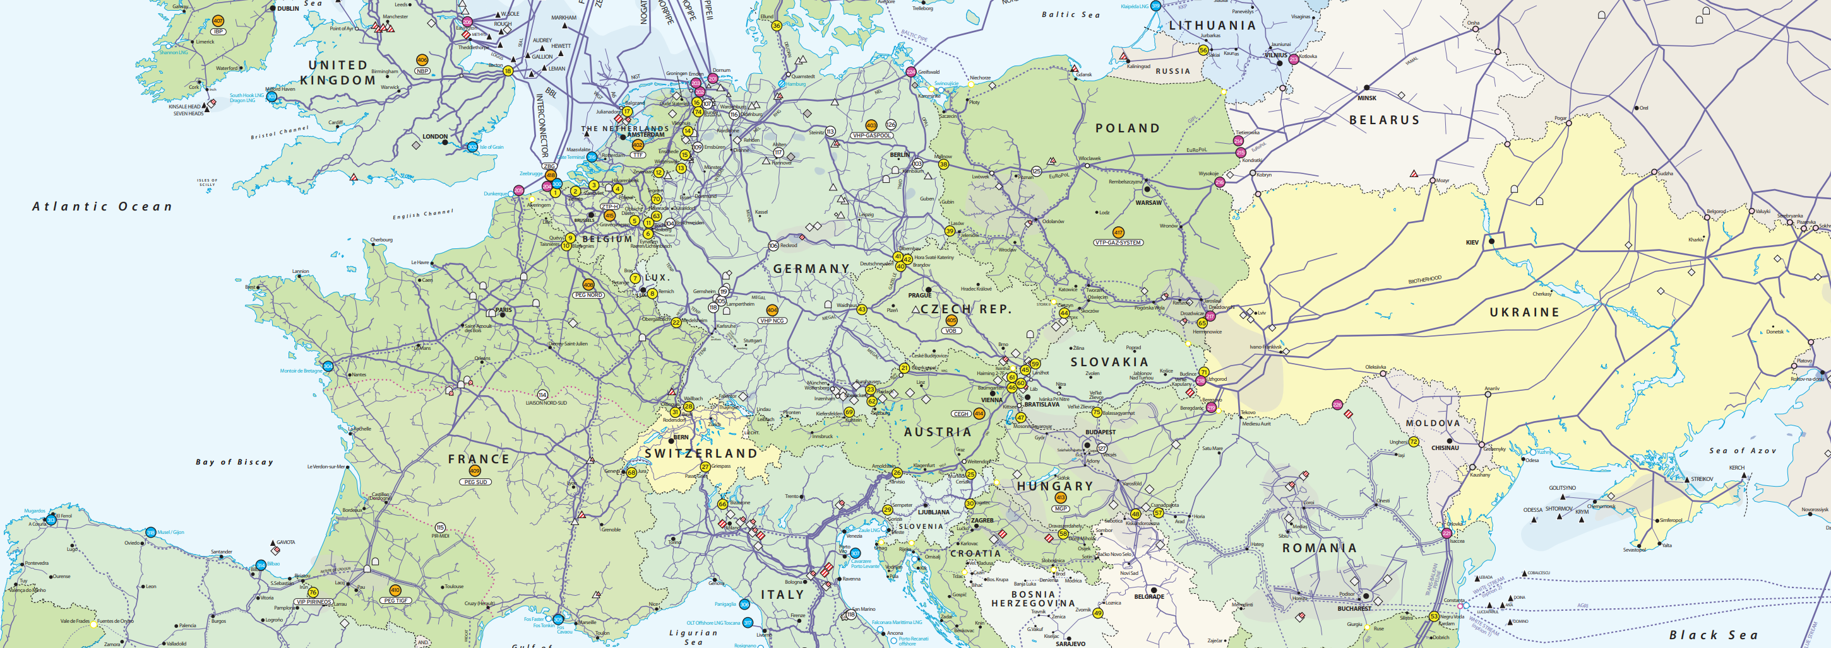
Transmission and distribution systems - gas
https://www.entsog.eu/sites/default/files/2018-10/ENTSOG_CAP_MAY2015_A0FORMAT.pdf
See also https://www.fluxys.com/en/company/fluxys-belgium/infrastructure

Slide 35
Transmission and distribution systems
Other networks: oil, wood, etc.

Slide 36
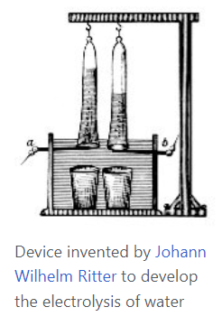
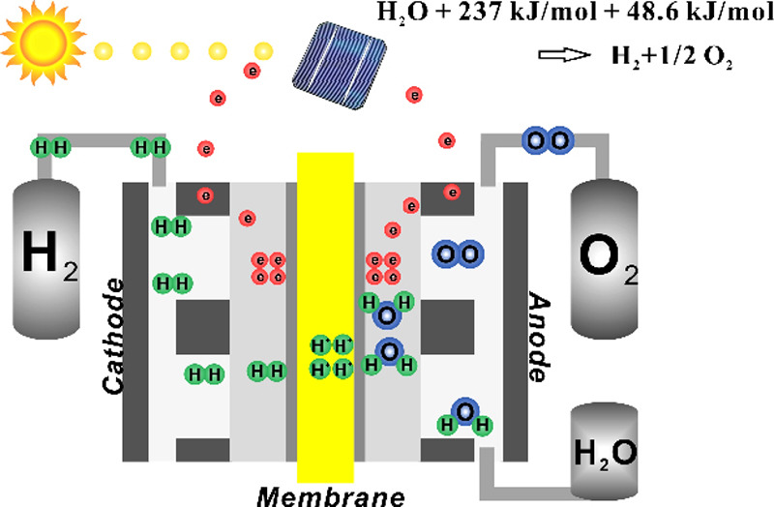
Conversion systems – clean hydrogen
Hydrogen is necessary for industry, and can be a solution for long term storage of renewable energy (e.g. to cope with seasonal variation of PV generation)
Hydrogen currently mostly generated from fossiel fuels
Need to move towards clean hydrogen. What is it?
Wikipedia:

Slide 37
What about the efficiency of clean hydrogen production?
Considering the industrial production of hydrogen, and using current best processes for water electrolysis (PEM or alkaline electrolysis)
which have an effective electrical efficiency of 70–80%,[46][47][48]
producing 1 kg of hydrogen (which has a specific energy of 143 MJ/kg) requires 50–55 kW⋅h (180–200 MJ) of electricity.
As of 2022, different analysts predict annual manufacture of equipment by 2030 as 47 GW, 104 GW and 180 GW, respectively.[50]
Source: https://en.m.wikipedia.org/wiki/Electrolysis_of_water

Slide 38
Note on clean hydrogen
Green hydrogen has been hailed as a clean energy source for the future.
But the gas itself is invisible – so why are so many colourful descriptions used when referring to it?
It all comes down to the way it is produced. Hydrogen emits only water when burned. But creating it can be carbon intensive.
So various ways to lessen this impact have been developed – and scientists assign colours to the different types to distinguish between them.
Depending on production methods, hydrogen can be grey, blue or green – and sometimes even pink, yellow or turquoise – although naming conventions can vary across countries and over time.
But green hydrogen is the only type produced in a climate-neutral manner, meaning it could play a vital role in global efforts to reduce emissions to net zero by 2050.
Source: https://www.weforum.org/agenda/2021/07/clean-energy-green-hydrogen/

Slide 39
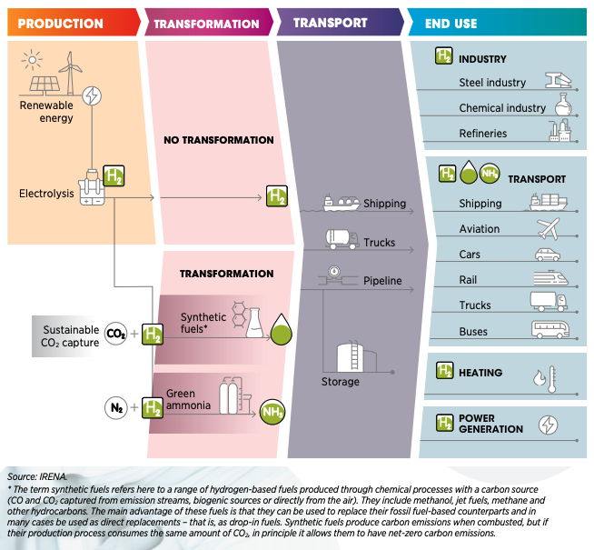
Conversion systems –Synthetic fuels

Slide 40
Energy planning is a very complex problem
Energy impacts all aspects of life
There is much uncertainty on technologies, efficiencies, availability of resources
Networks must be built to transmit energy in various forms
We must work on the demand side as well
We inherit from the current situation
State budgets are limited
Transition should be fast
Many actors make decisions => huge need for coordination
… There is no easy solution

Slide 41
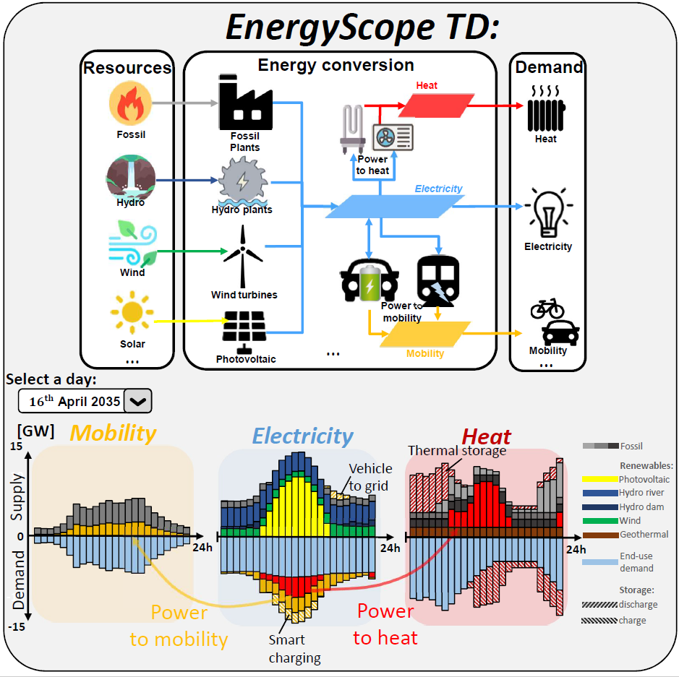
The energy scope model
The EnergyScope project is an open-source whole-energy system for regional energy system. The model optimises the design and hourly operation over a year for a target year.
EnergyScope is mainly developped by EPFL (Switzerland) and UCLouvain (Belgium). See Releases section for acknowledgment, versions and publications.
Reference: Gauthier Limpens, Stefano Moret, Hervé Jeanmart, and Francois Maréchal. EnergyScope TD: A novel open-source model for regional energy systems. Applied Energy, 255(March):113729, 2019.
Source: https://energyscope-td.readthedocs.io/en/master/index.html#

Slide 42
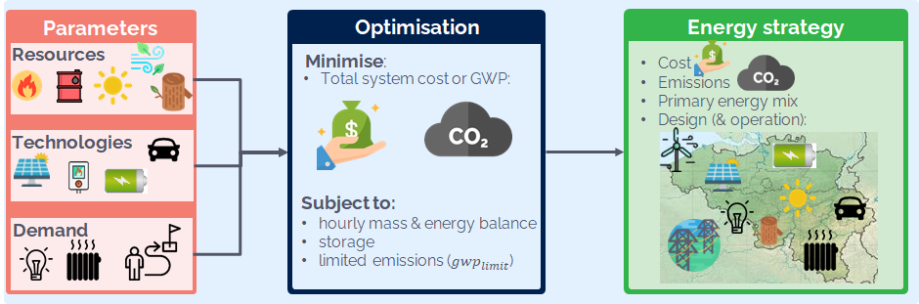
The planning problem is modeled as a large linear optimisation problem
Overview of the LP modeling framework
Source: https://energyscope-td.readthedocs.io/en/master/sections/Model%20formulation.html

Slide 43
(

Slide 44
What is an optimisation problem?
Mathematical programming is a field of applied mathematics that deals with solving optimization problems.
It provides a framework and solution methods for computing the decisions of an optimization problem, given an objective function to minimize or maximize and constraints on the decision variables.
Mathematical programming relies on a model of the problem.
There is a large variety of mathematical programming problem types, depending on the characteristics of the objective function and of the constraints, and the restrictions that apply to variables.

Slide 45

Linear program, mathematical formulation
If the objective is linear and the constraints are linear, we talk about linear programming (LP) or linear optimization.
These problems are nowadays easy to solve, even for large problems (millions of decision variables), with standard computers.

Slide 46
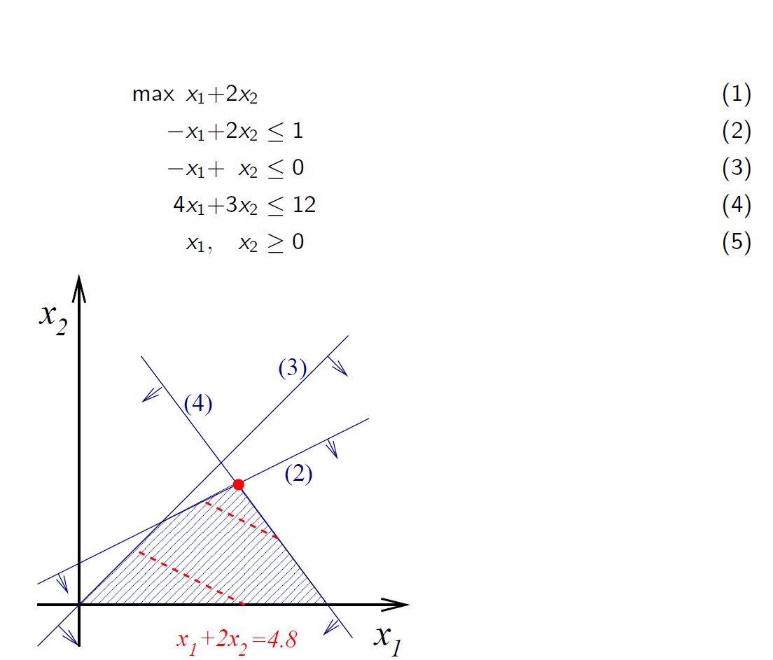
Graphic representation

Slide 47
)

Slide 48
Details of the energy scope model
satisfy the system end-use demand (EUD) instead of final energy consumption
The system end-use demand comprises electricity, heat, transport, and non-energy demands. For instance, passenger mobility is defined in passenger kilometers per year rather than in a certain amount of gasoline to fuel cars or electricity to power trains;
optimizing the system design and operation by minimizing its overall cost;
using an hourly resolution which makes the model suitable for analyzing the integration of intermittent renewable energy resources and storage;
modeling the country as a single node where transmissions constraints within the country are not considered
For details, see https://energyscope-td.readthedocs.io/en/master/sections/Model%20formulation.html

Slide 49
Energy planning and EROI
Summary of
Dumas, Jonathan, Antoine Dubois, Paolo Thiran, Pierre Jacques, Francesco Contino, Bertrand Cornélusse, and Gauthier Limpens. "The energy return on investment of whole energy systems: application to Belgium." arXiv preprint arXiv:2205.06727 (2022). To appear in Biophysical Economics and Sustainability.

Slide 50
Motivation
Planning the defossilization of energy systems while maintaining access to abundant primary energy resources is a nontrivial multi-objective problem encompassing economic, technical, environmental, and social aspects.
However, most long-term policies consider the cost of the system as the leading indicator in the energy system models to decrease the carbon footprint.
EROI
Instead

Slide 51
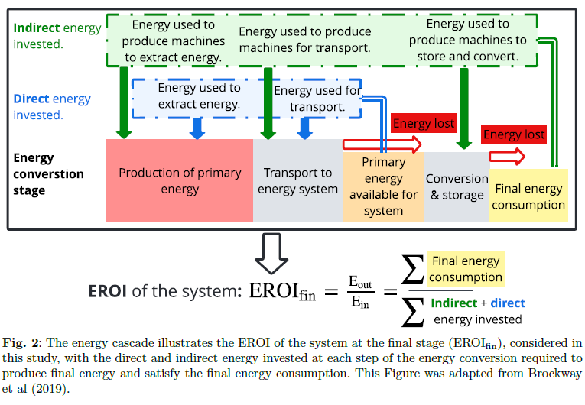
What is the EROI: Energy return on energy invested

Slide 52
Comments
The lower the EROI of an energy source, the more input energy is required to produce the output energy, which results in less net energy available for consumption.
The literature about EROI focuses mainly on three main fields of research:
(1) the link between EROI and societal well-being;
(2) estimation of the EROI of an energy resource or technology;
(3) estimation of the EROI at the level of an economy or a society.

Slide 53
(1) Link between EROI and societal well-being
The estimated societal EROI is correlated with the Human Development Index (HDI), which is a standard living indicator.
However, for a few countries with a high level of development, HDI above 0.75, there is a saturation point where increasing the EROI above 20 is not associated with further improvement in society.
In addition, the relationship between EROI and HDI is non-linear as the HDI increases less and less rapidly with societal EROI.

Slide 54
(2) Estimation of the EROI of an energy resource or technology
The characteristics of the primary energy sources, including the EROI of each fuel, are investigated by Hall et al. [7].
They conclude that:
(i) the EROI of critical fuels, such as oil and gas, is declining;
(ii) most renewable and non-conventional energy alternatives have substantially lower EROI values than traditional conventional fossil fuels.
Another more recent study [8] estimates the EROI of fossil fuels at both primary and final energy stages. However, their results suggest that the current EROIoffossil fuels may not differ from the EROI of renewables, which illustrates the difficulty of adequately assessing the EROI of resources or technologies.
References relate to « Dumas, Jonathan, Antoine Dubois, Paolo Thiran, Pierre Jacques, Francesco Contino, Bertrand Cornélusse, and Gauthier Limpens. "The energy return on investment of whole energy systems: application to Belgium." arXiv preprint arXiv:2205.06727 (2022). To appear in Biophysical Economics and Sustainability. »

Slide 55
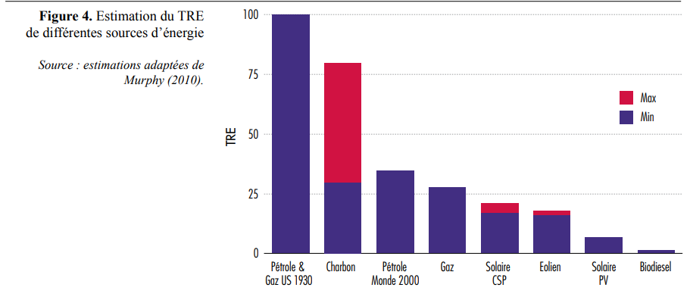
(2) Estimation of the EROI of an energy resource or technology (…)
Source: DUPONT, Elise, JEANMART, Hervé, POSSOZ, Louis, et al. Transition énergétique et (dé) croissance économique. Université catholique de Louvain, Institut de Recherches Economiques et Sociales (IRES), 2017.
https://www.regards-economiques.be/images/reco-pdf/reco_175.pdf

Slide 56
(3) The estimation of the EROI at the level of an economy or a society
This is precisely the topic of the paper. Why?
It is not relevant to compare the EROI of renewable resources or technologies independently. For instance, solar and wind energies are intermittent and stochastic. Gas and nuclear power plants are adjustable and can meet fluctuating demand. Thus, comparing the EROI of solar vs. nuclear without considering storage systems and other assets to balance the system is not pertinent.
Second, a whole energy system comprises several sectors (mobility, heat, electricity, industry) that use several technologies and resources that can be imported or extracted. These resources are transported, stored, and converted by energy conversion technologies to supply end-use demands such as electricity, transport, heating, and the production of goods. Assessing an energy system as a whole opens the opportunity for the full deployment of synergies and generates unexpected results [15]. Thus, the EROI of the system cannot be the sum of the EROI of each of its components.
EnergyScope was adapted to work with the EROI as an objective function.The case of Belgium in 2035 was investigated.

Slide 57
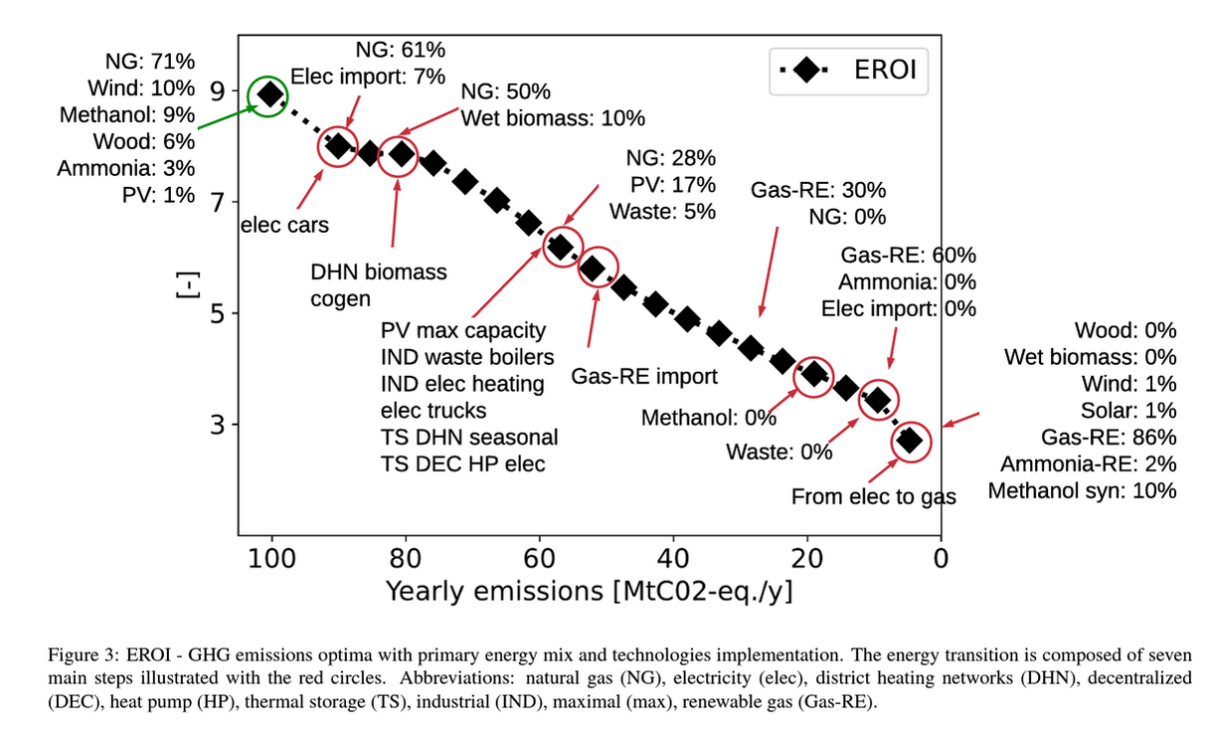
Results

Slide 58
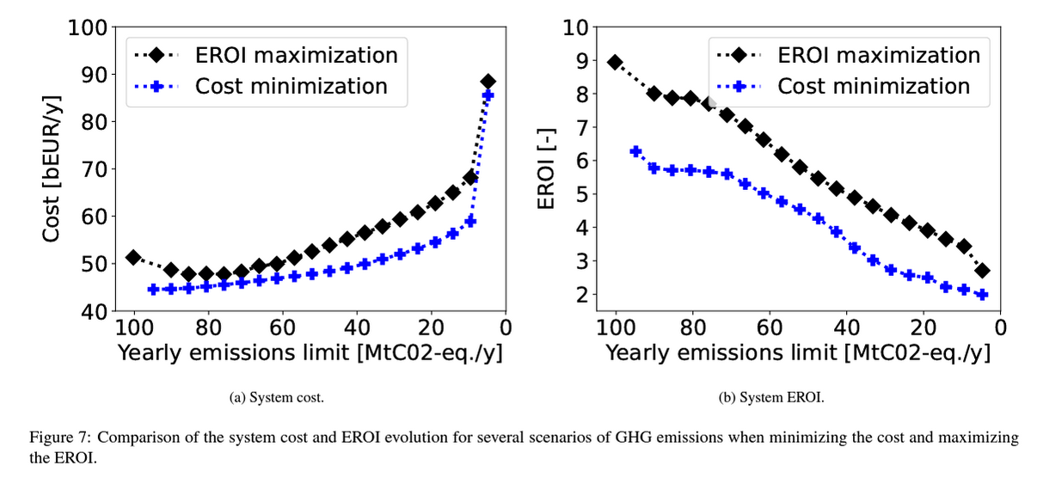
Results

